Slide 1
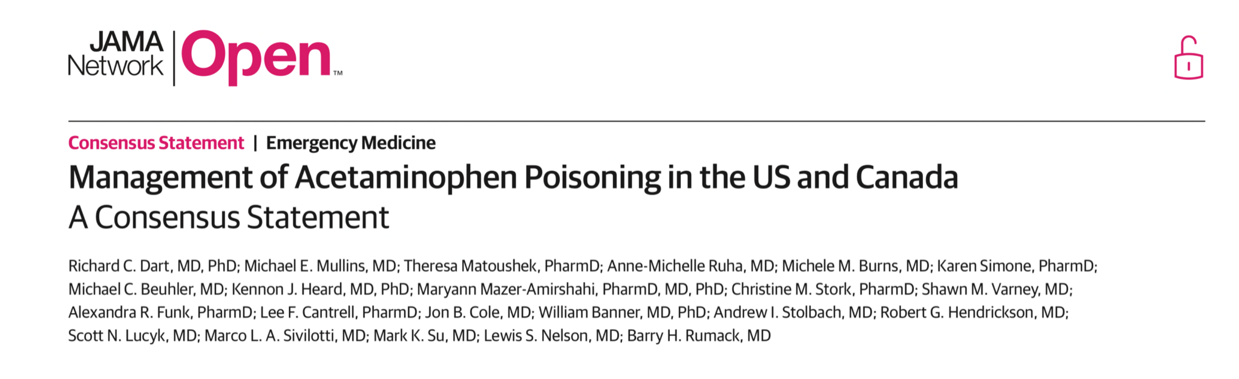
Management of Acetaminophen Poisoning 2023
Nattawit Kaewkomot MD.
Notes:
Background
<a href="https://www.freepik.com/free-photos-vectors/business">Business vector created by pikisuperstar - www.freepik.com</a>
Cheery Blossom
<a href="https://www.freepik.com/free-photos-vectors/banner">Banner vector created by freepik - www.freepik.com</a>

Slide 2
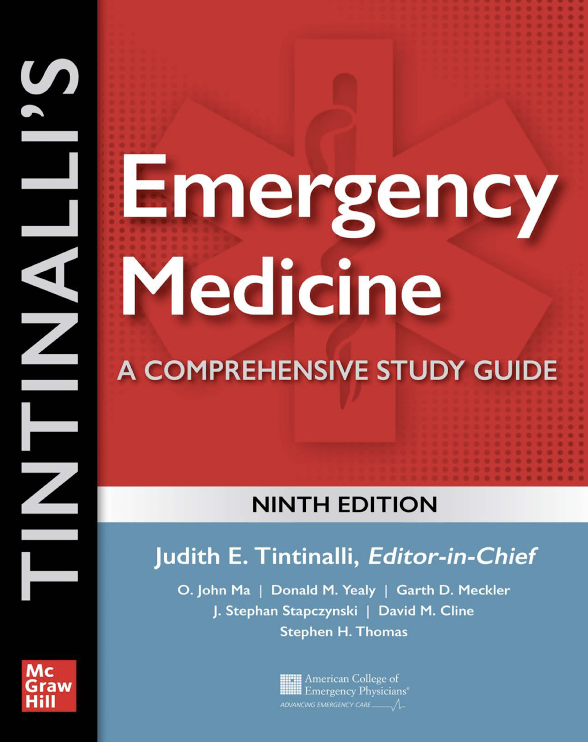
References
Notes:
Japanese people
<a href="https://www.freepik.com/free-photos-vectors/background">Background vector created by macrovector - www.freepik.com</a>
Cheery Blossom
<a href="https://www.freepik.com/free-photos-vectors/banner">Banner vector created by freepik - www.freepik.com</a>

Slide 3
Abstract
IMPORTANCE
The US and Canada currently have no formal published nationwide guidelines for the management of acetaminophen poisoning, resulting in significant variability in management.
OBJECTIVE
To develop consensus guidelines for the management of acetaminophen poisoning in the US and Canada.
Notes:
Background
<a href="https://www.freepik.com/free-photos-vectors/background">Background vector created by freepik - www.freepik.com</a>
Cheery Blossom
<a href="https://www.freepik.com/free-photos-vectors/banner">Banner vector created by freepik - www.freepik.com</a>

Slide 4
Abstract
EVIDENCE REVIEW
Selected participants (n = 21) from Four clinical toxicology societies
March 2021 - March 2023
America’s Poison Centers
American Academy of Clinical Toxicology
American College of Medical Toxicology
Canadian Association of Poison Control Centers
FINDINGS
84 guidelines and 278 publications retrieved → 5 guidelines and 7 publications met evidence quality
Notes:
Background
<a href="https://www.freepik.com/free-photos-vectors/background">Background vector created by freepik - www.freepik.com</a>
Cheery Blossom
<a href="https://www.freepik.com/free-photos-vectors/banner">Banner vector created by freepik - www.freepik.com</a>

Slide 5
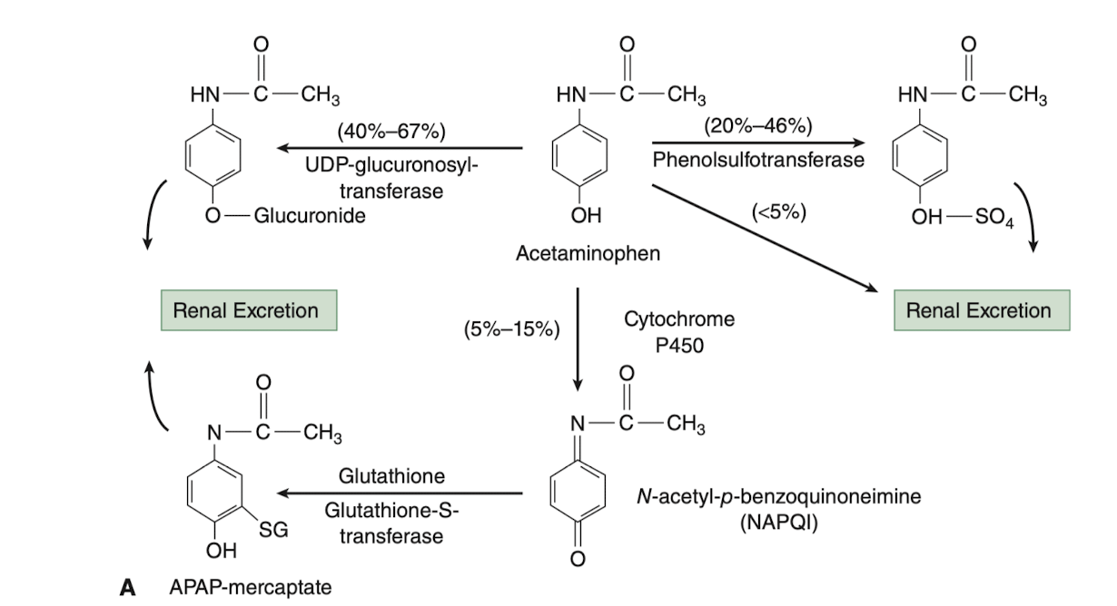
Introduction
Notes:
Background
<a href="https://www.freepik.com/free-photos-vectors/background">Background vector created by freepik - www.freepik.com</a>
Cheery Blossom
<a href="https://www.freepik.com/free-photos-vectors/banner">Banner vector created by freepik - www.freepik.com</a>

Slide 6
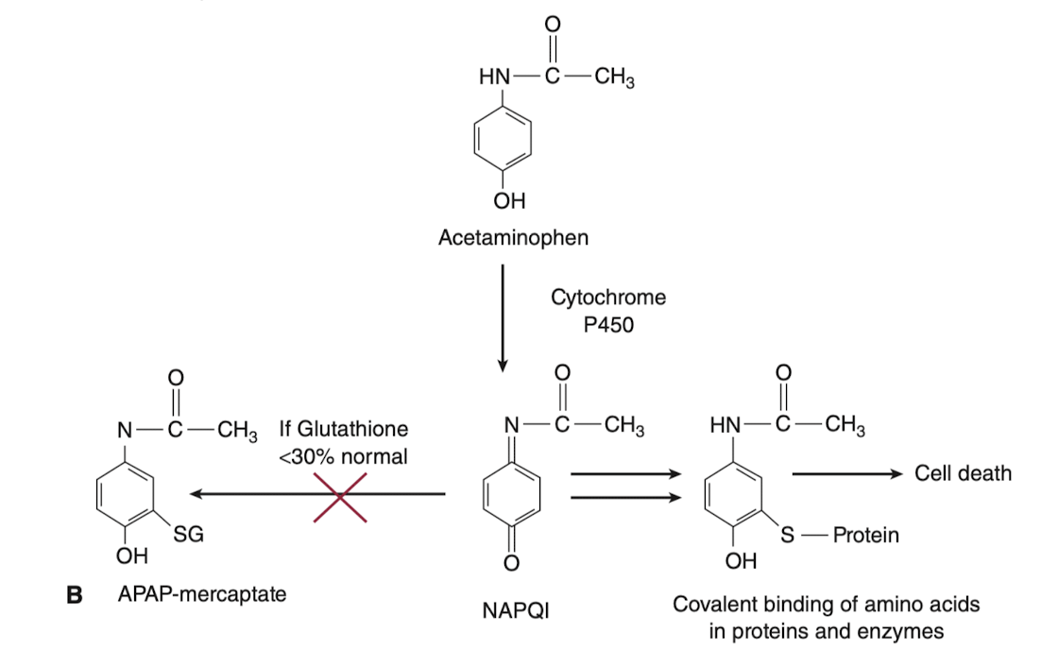
Introduction
Notes:
Background
<a href="https://www.freepik.com/free-photos-vectors/background">Background vector created by freepik - www.freepik.com</a>
Cheery Blossom
<a href="https://www.freepik.com/free-photos-vectors/banner">Banner vector created by freepik - www.freepik.com</a>

Slide 7
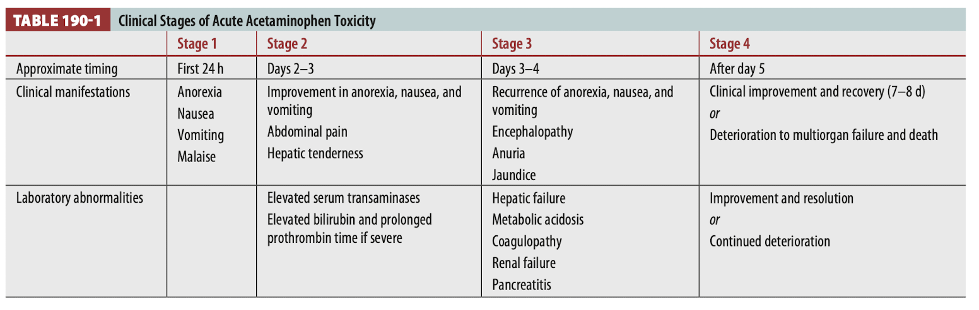
Introduction
Notes:
Background
<a href="https://www.freepik.com/free-photos-vectors/background">Background vector created by freepik - www.freepik.com</a>
Cheery Blossom
<a href="https://www.freepik.com/free-photos-vectors/banner">Banner vector created by freepik - www.freepik.com</a>

Slide 8
Outline
1
Management of Suspected Acute Ingestion of Immediate-Release Acetaminophen Products
2
Administration of Acetylcysteine
3
Special conditions
Notes:
Cheery Blossom
<a href="https://www.freepik.com/free-photos-vectors/banner">Banner vector created by freepik - www.freepik.com</a>
Cat
<a href="https://www.freepik.com/free-photos-vectors/business">Business vector created by pikisuperstar - www.freepik.com</a>

Slide 9
Outline
1
Management of Suspected Acute Ingestion of Immediate-Release Acetaminophen Products
2
Administration of Acetylcysteine
3
Special conditions
Notes:
Cheery Blossom
<a href="https://www.freepik.com/free-photos-vectors/banner">Banner vector created by freepik - www.freepik.com</a>
Cat
<a href="https://www.freepik.com/free-photos-vectors/business">Business vector created by pikisuperstar - www.freepik.com</a>

Slide 10
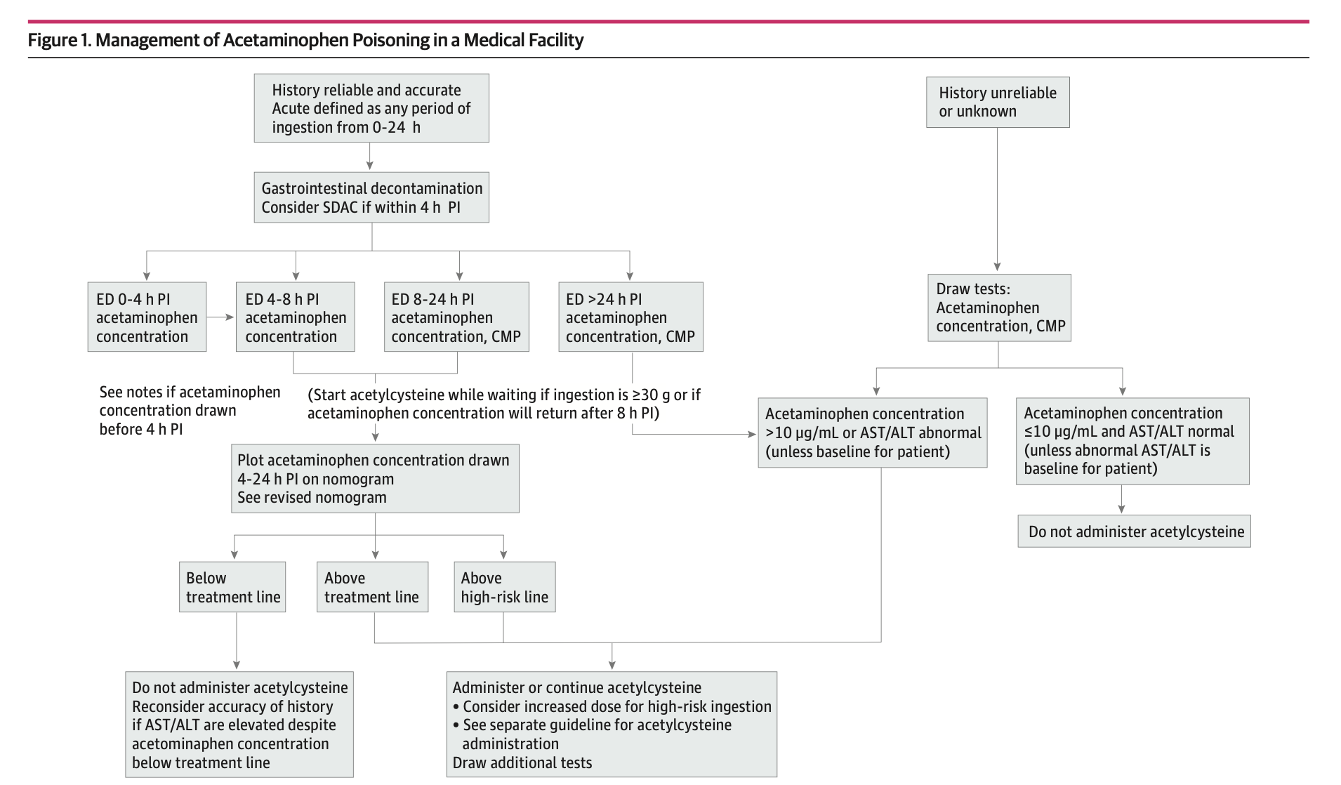
Management of Suspected Acute Ingestion of Immediate-Release Acetaminophen Products
Notes:
Background
<a href="https://www.freepik.com/free-photos-vectors/background">Background vector created by freepik - www.freepik.com</a>
Cheery Blossom
<a href="https://www.freepik.com/free-photos-vectors/banner">Banner vector created by freepik - www.freepik.com</a>

Slide 11
High-Risk Acetaminophen Ingestion
High-risk ingestion
Ingestion of at least 30 grams of acetaminophen
or acetaminophen concentration above the high-risk line on the nomogram
Additional laboratory testing
Indicated if developed signs of mitochondrial dysfunction; altered level of consciousness, metabolic acidosis, or hyperlactatemia.
should include evaluation of other causes of altered level of consciousness
Increased dosage of acetylcysteine(NAC)
may be warranted in consultation with a Poison Center(PC) or clinical toxicologist
Notes:
Background
<a href="https://www.freepik.com/free-photos-vectors/background">Background vector created by freepik - www.freepik.com</a>
Cheery Blossom
<a href="https://www.freepik.com/free-photos-vectors/banner">Banner vector created by freepik - www.freepik.com</a>

Slide 12
Diagnosis Acetaminophen poisoning
A patient ≥6 years old ingests
>10 grams or 200 mg/kg as a single ingestion
>10 grams or 200 mg/kg over a 24-hour period
>6 grams or 150 mg/kg per 24-hour period for at least 2 consecutive days
For children <6 years old ingests
> 200 mg/kg of acetaminophen as a single ingestion or over an 8-hour
>150 mg/kg per 24-hour period for the preceding 48 hour
Massive Acetaminophen Overdose: >40 grams or 500 mg/kg

Slide 13
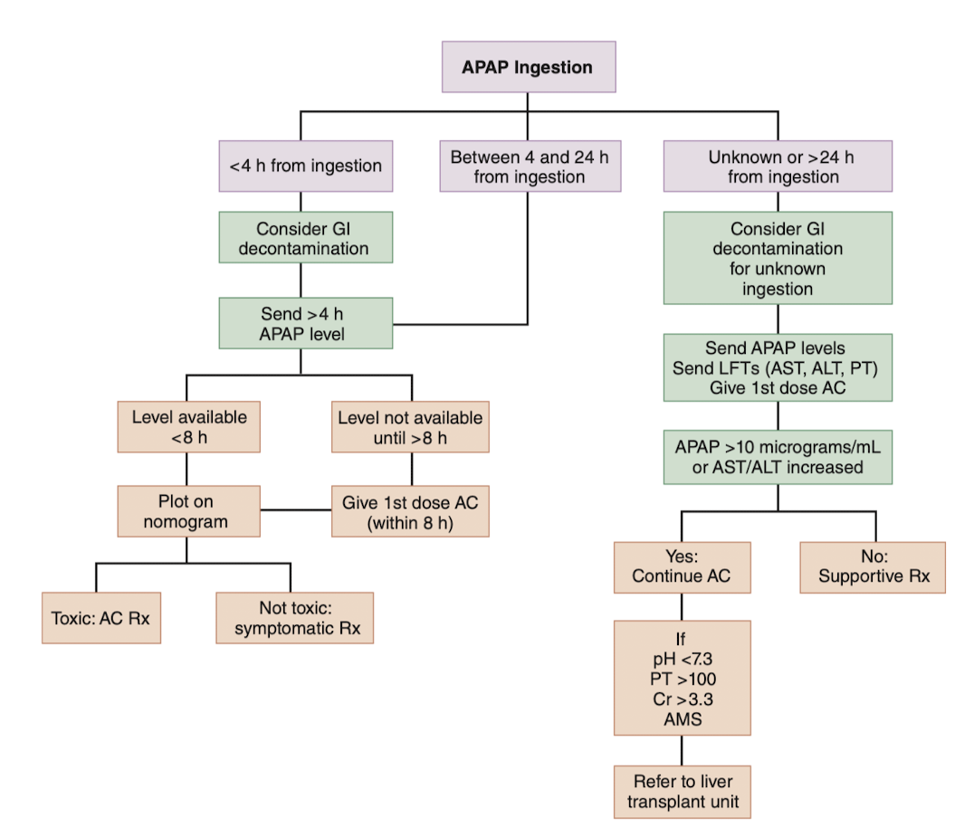
Management of Suspected Acute Ingestion of Immediate-Release Acetaminophen Products

Slide 14
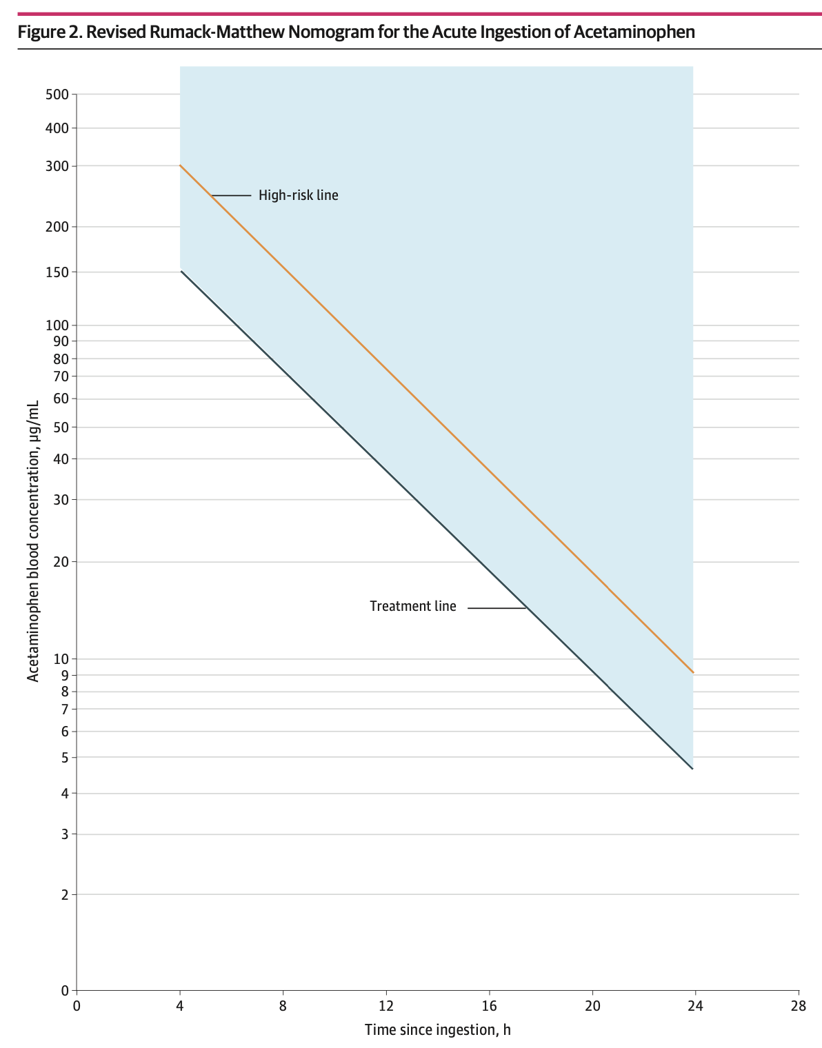
Nomogram
Notes:
Background
<a href="https://www.freepik.com/free-photos-vectors/background">Background vector created by freepik - www.freepik.com</a>
Cheery Blossom
<a href="https://www.freepik.com/free-photos-vectors/banner">Banner vector created by freepik - www.freepik.com</a>

Slide 15
Outline
1
Management of Suspected Acute Ingestion of Immediate-Release Acetaminophen Products
2
Administration of Acetylcysteine
3
Special conditions
Notes:
Cheery Blossom
<a href="https://www.freepik.com/free-photos-vectors/banner">Banner vector created by freepik - www.freepik.com</a>
Cat
<a href="https://www.freepik.com/free-photos-vectors/business">Business vector created by pikisuperstar - www.freepik.com</a>

Slide 16
Administration of Acetylcysteine
administered orally or intravenously
administered initial dose as soon as the need for treatment becomes evident
>15 different regimens identified, but the comparative effectiveness has not been evaluated
Recommended use of at least 300 mg/kg orally or IV during the first 20 to 24 hours of treatment
Calculation of acetylcysteine dose should be capped at 100 kg of body weight
Notes:
Background
<a href="https://www.freepik.com/free-photos-vectors/background">Background vector created by freepik - www.freepik.com</a>
Cheery Blossom
<a href="https://www.freepik.com/free-photos-vectors/banner">Banner vector created by freepik - www.freepik.com</a>

Slide 17
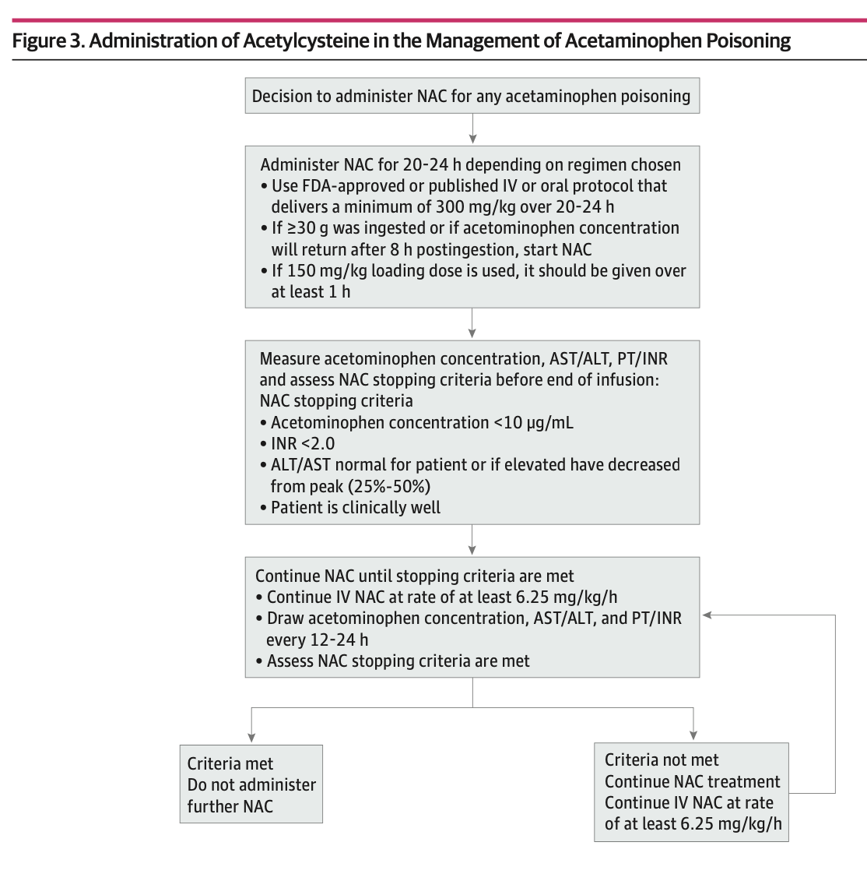
A strong clinical concern of acute overdose (if dose was >200 mg/kg or >10 g)
→ Acetylcysteine should be administered before the acetaminophen concentration is available

Slide 18
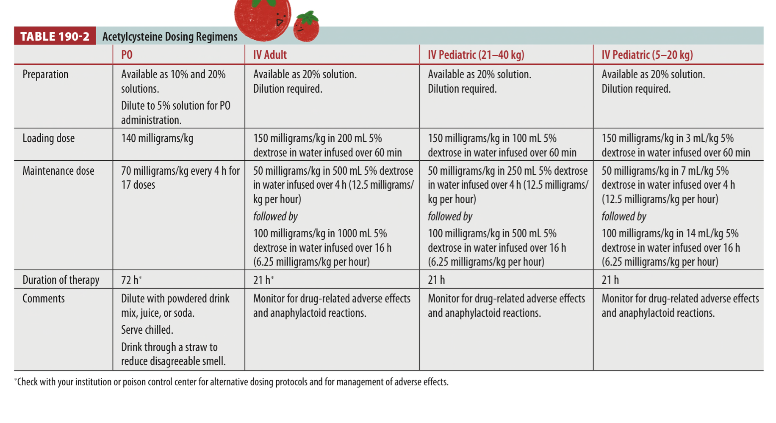
Given the volume and hypotonicity of fluid required, specific acetylcysteine weight-based fluid volume guidelines should be followed for children and small adults (<40 kg), and these patients should be carefully monitored to avoid fluid overload and hyponatremia during treatment.

Slide 19


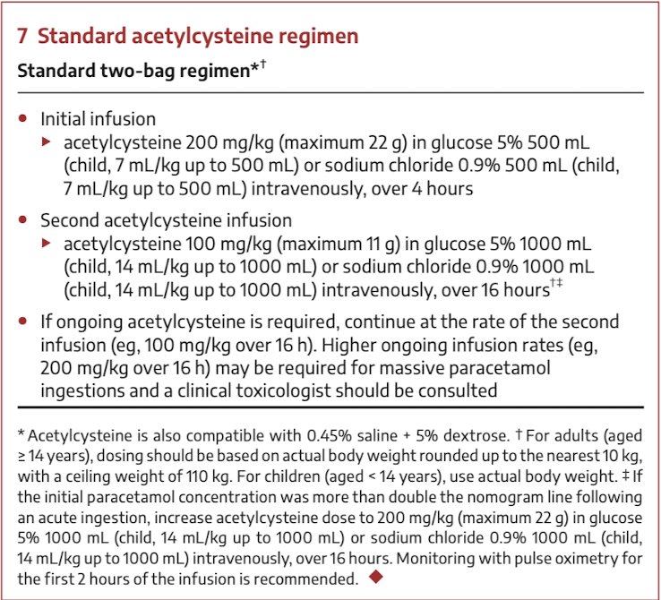

Slide 20

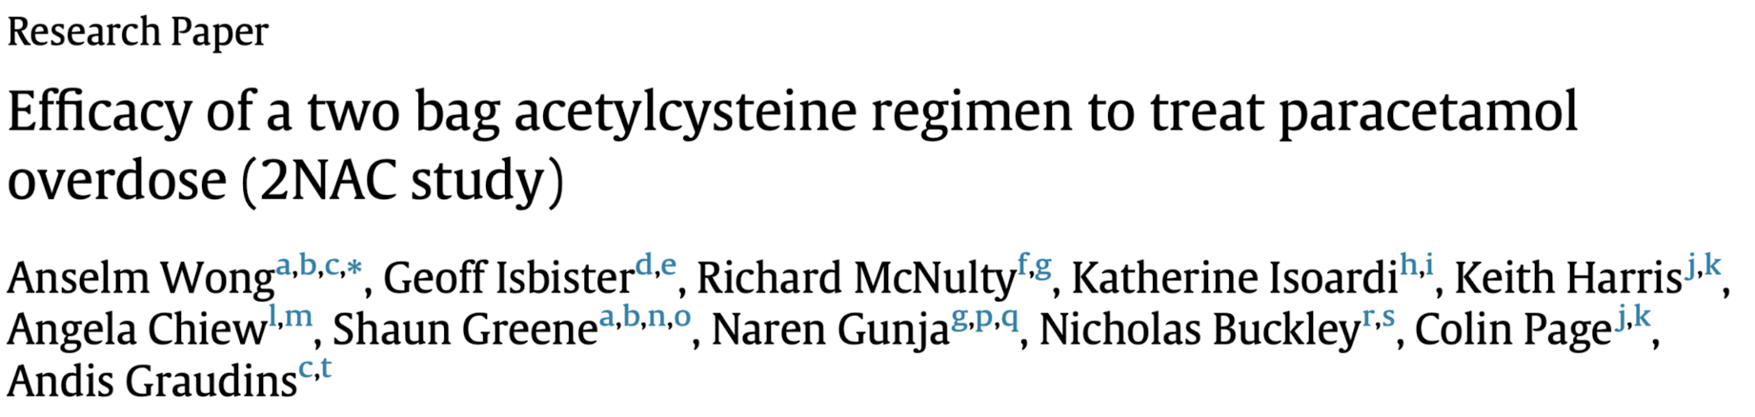

two- bag regimen resulted in 3 episodes of severe non-allergic anaphylactic reactions
three-bag regimen resulted in 15 episodes of severe non-allergic anaphylactic reaction
No statistical analysis evidence
Significantly less cutaneous and systemic non-allergic anaphylactic reactions
two-bag and three-bag regimen (1.3% [n = 17] and 7.1% [n = 65]
RiskDifference: 5.8%, 95%CI 7.6 to 4.0, p < 0.0001
Significantly less gastrointestinal reactions (nausea and/or vomiting)
two-bag and three-bag regimen (19% [n = 245] vs 31% [n = 279], p < 0.0001

Slide 21
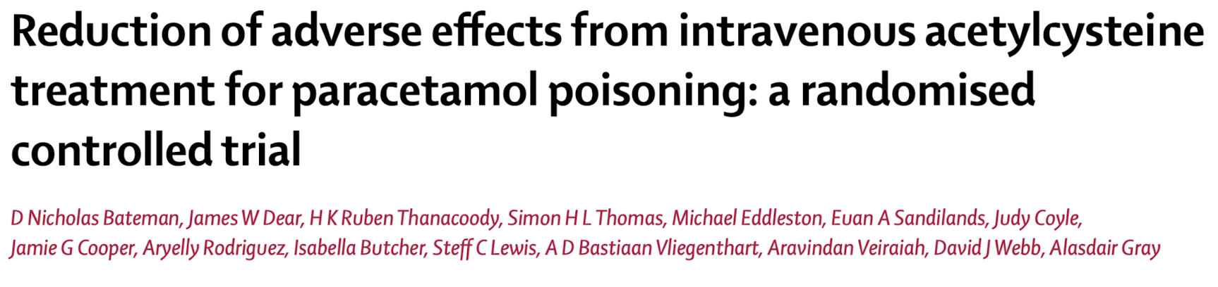
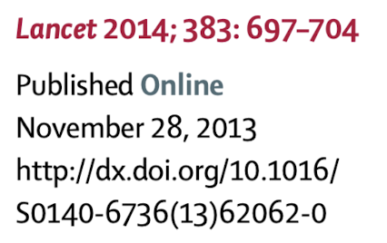
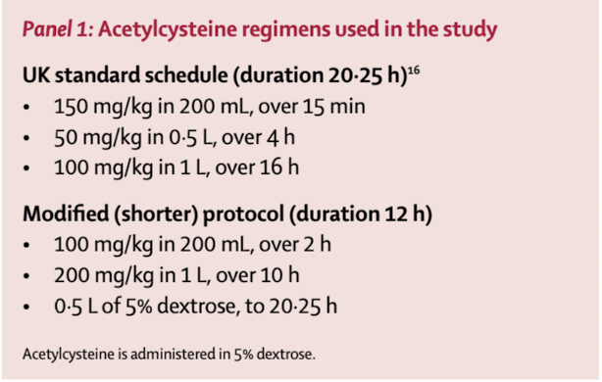

Slide 22
Outline
1
Management of Suspected Acute Ingestion of Immediate-Release Acetaminophen Products
2
Administration of Acetylcysteine
3
Special conditions
Notes:
Cheery Blossom
<a href="https://www.freepik.com/free-photos-vectors/banner">Banner vector created by freepik - www.freepik.com</a>
Cat
<a href="https://www.freepik.com/free-photos-vectors/business">Business vector created by pikisuperstar - www.freepik.com</a>

Slide 23
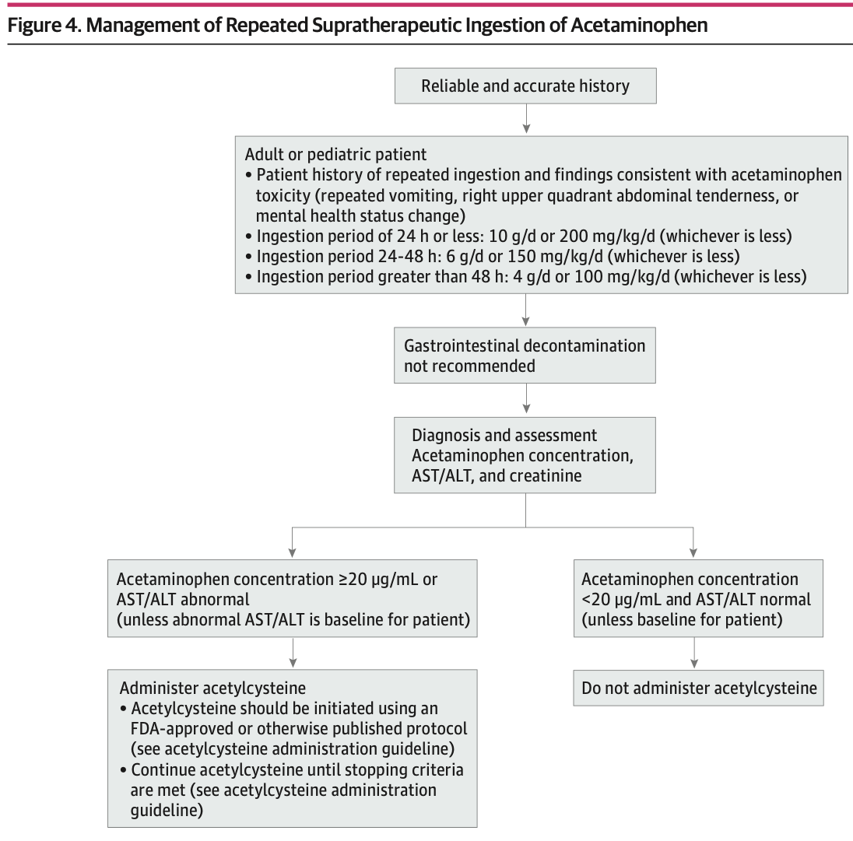
Management of Repeated Supratherapeutic Ingestion
Repeated Supratherapeutic Ingestion
Defined as multiple ingestions for a period >24 hours
Acetylcysteine(NAC) should be administered if
Acetaminophen concentration >20 μg/mL
Or the aspartate aminotransferase(AST) or alanine aminotransferase(ALT) level is abnormal
Notes:
Background
<a href="https://www.freepik.com/free-photos-vectors/background">Background vector created by freepik - www.freepik.com</a>
Cheery Blossom
<a href="https://www.freepik.com/free-photos-vectors/banner">Banner vector created by freepik - www.freepik.com</a>

Slide 24
Ingestion of Extended-Release Acetaminophen Products
Extended-Release Acetaminophen Products
Defined as acetaminophen products labeled for use on an 8-hour basis
The same management as ingestion of other acetaminophen products
Except that activated charcoal may be useful longer than 4 hours after ingestion if evidence of ongoing absorption is present (e.g. an increasing acetaminophen concentration).
Acetaminophen concentration at 4 to 12 hours after ingestion
If below the treatment line but >10 μg/mL, it should be measured again 4 to 6 hours after the first measurement
Notes:
Background
<a href="https://www.freepik.com/free-photos-vectors/background">Background vector created by freepik - www.freepik.com</a>
Cheery Blossom
<a href="https://www.freepik.com/free-photos-vectors/banner">Banner vector created by freepik - www.freepik.com</a>

Slide 25
Coingestion of Acetaminophen and Anticholinergic or Opioid Agonist Medications
Acetaminophen absorption may be delayed or prolonged
The same management as ingestion of other acetaminophen products
Acetaminophen concentration at 4 to 24 hours after ingestion
If below the treatment line but >10 μg/mL, it should be measured again 4 to 6 hours after the first measurement
If <10 μg/mL, another measurement need not be taken and acetylcysteine treatment is not needed
Notes:
Background
<a href="https://www.freepik.com/free-photos-vectors/background">Background vector created by freepik - www.freepik.com</a>
Cheery Blossom
<a href="https://www.freepik.com/free-photos-vectors/banner">Banner vector created by freepik - www.freepik.com</a>

Slide 26
Acute Ingestion of Immediate-Release Acetaminophen
4h after ingestion
If unknown time of ingestion → Measured immediately
Repeated Supratherapeutic Ingestion
If the acetaminophen concentration >20 μg/mL → Tx NAC
Ingestion of Extended-Release Acetaminophen Products
If the concentration 4 to 12 hours after ingestion
below treatment line but >10 μg/mL: measured again 4 to 6 hours after the first measurement
Co-ingestion of Acetaminophen and Anticholinergic or Opioid Agonist Medications
If the concentration 4 to 24 hours after ingestion
below treatment line but >10 μg/mL: measured again 4 to 6 hours after the first measurement
<10 μg/mL: no need for another measurement and acetylcysteine treatment.
Notes:
Background
<a href="https://www.freepik.com/free-photos-vectors/background">Background vector created by freepik - www.freepik.com</a>
Cheery Blossom
<a href="https://www.freepik.com/free-photos-vectors/banner">Banner vector created by freepik - www.freepik.com</a>

Slide 27
Patients Younger Than 6 Years
PC or clinical toxicologist if
a cumulative dose of >150 mg/kg body weight during 24 hours
a single intravenous dose of acetaminophen of 90 mg/kg body weight
Management in patients <6 years is the same as for older patients
Administration of acetylcysteine requires weight-based adjustment to avoid hyponatremia for patients who weigh less than 41 kg.
Notes:
Background
<a href="https://www.freepik.com/free-photos-vectors/background">Background vector created by freepik - www.freepik.com</a>
Cheery Blossom
<a href="https://www.freepik.com/free-photos-vectors/banner">Banner vector created by freepik - www.freepik.com</a>

Slide 28
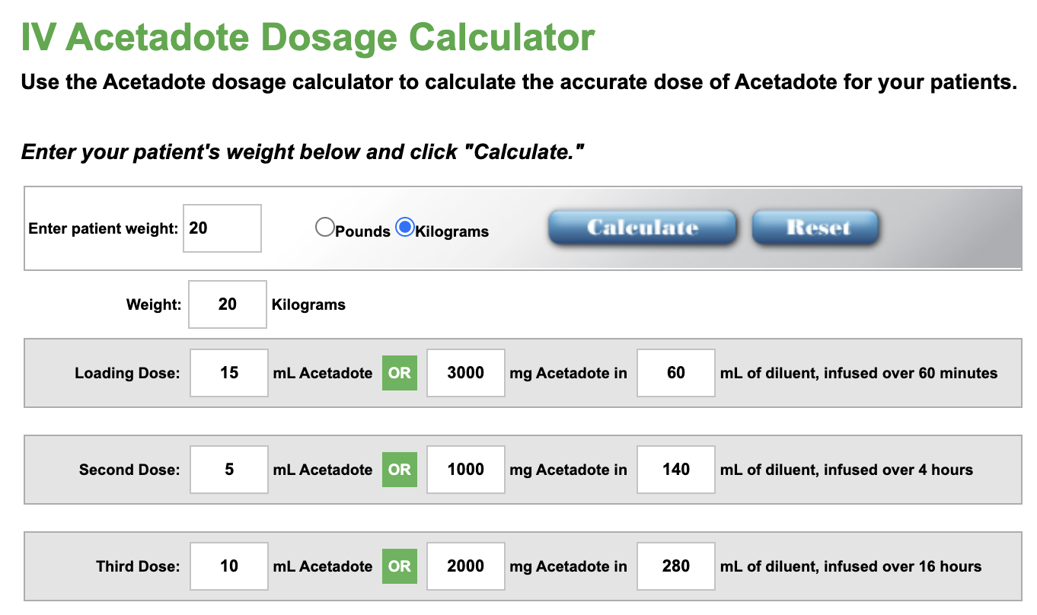
Patients Younger Than 6 Years
Acetadote.com
Available dose calculator and detailed pediatric dilution directions for IV acetylcysteine
Notes:
Background
<a href="https://www.freepik.com/free-photos-vectors/background">Background vector created by freepik - www.freepik.com</a>
Cheery Blossom
<a href="https://www.freepik.com/free-photos-vectors/banner">Banner vector created by freepik - www.freepik.com</a>

Slide 29
Pregnancy
The standard evaluation and management of acetaminophen poisoning are the same in the pregnant patient
Except that some clinicians prefer the intravenous route for acetylcysteine administration. However, no data are available to demonstrate that the oral route is less effective in the pregnant patient.
Notes:
Background
<a href="https://www.freepik.com/free-photos-vectors/background">Background vector created by freepik - www.freepik.com</a>
Cheery Blossom
<a href="https://www.freepik.com/free-photos-vectors/banner">Banner vector created by freepik - www.freepik.com</a>

Slide 30
Use of Enhanced Elimination Techniques
Hemodialysis is recommended in addition to treatment with acetylcysteine
Acetaminophen concentration of 900 μg/mL or greater
Acidosis or Altered consciousness due to acetaminophen toxic effects
Acetylcysteine during hemodialysis
If the intravenous route is used, the rate of acetylcysteine infusion should be at least 12.5 mg/kg/hour.
If the oral acetylcysteine regimen is used, it does not require adjustment.
Notes:
Background
<a href="https://www.freepik.com/free-photos-vectors/background">Background vector created by freepik - www.freepik.com</a>
Cheery Blossom
<a href="https://www.freepik.com/free-photos-vectors/banner">Banner vector created by freepik - www.freepik.com</a>

Slide 31
Consultation With Liver Transplant Team
Consider consultation with a liver transplant team if
Progressive increases in AST or ALT and coagulation abnormalities
With encephalopathy or multisystem failure despite acetylcysteine treatment.
Notes:
Background
<a href="https://www.freepik.com/free-photos-vectors/background">Background vector created by freepik - www.freepik.com</a>
Cheery Blossom
<a href="https://www.freepik.com/free-photos-vectors/banner">Banner vector created by freepik - www.freepik.com</a>

Slide 32
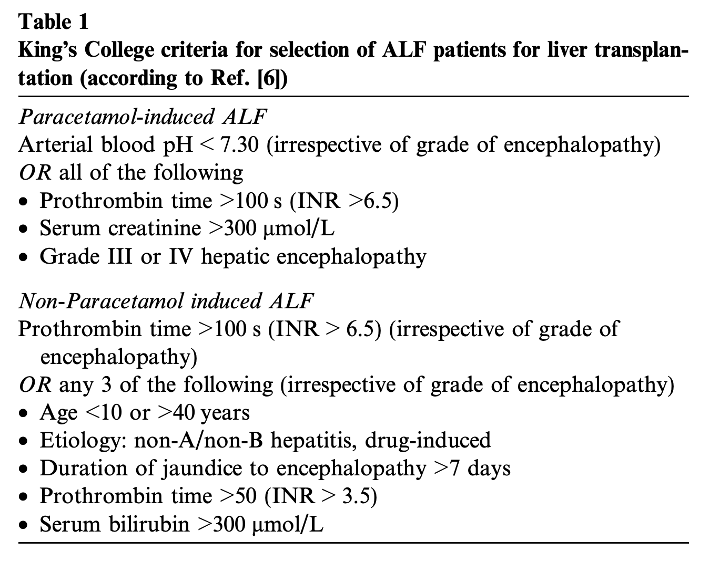
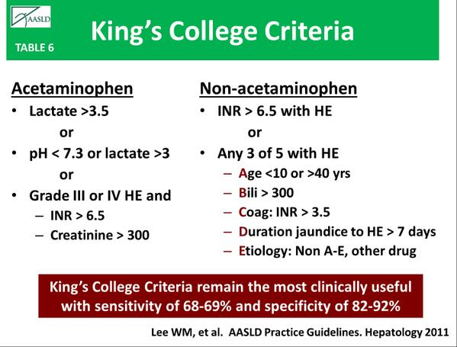
King’s College criteria for selection of ALF patients for liver transplantation
King’s College (original)
King’s College + Lactate* *as predictors of poor prognosis without transplant
Lactate
>3.5 mmol/L after early resuscitation
or >3.0 mmol/L after full resuscitation
i
Notes:
Background
<a href="https://www.freepik.com/free-photos-vectors/background">Background vector created by freepik - www.freepik.com</a>
Cheery Blossom
<a href="https://www.freepik.com/free-photos-vectors/banner">Banner vector created by freepik - www.freepik.com</a>

Slide 33
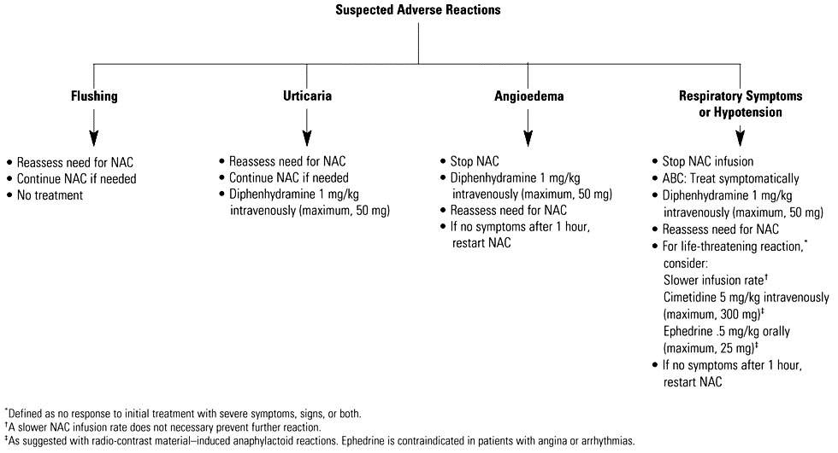
NAC Adverse reaction management
Notes:
Background
<a href="https://www.freepik.com/free-photos-vectors/background">Background vector created by freepik - www.freepik.com</a>
Cheery Blossom
<a href="https://www.freepik.com/free-photos-vectors/banner">Banner vector created by freepik - www.freepik.com</a>

Slide 34
Take Home Message
Acute Ingestion of Immediate-Release Acetaminophen
4h after ingestion
If unknown time of ingestion → Measured immediately
Repeated Supratherapeutic Ingestion
If the acetaminophen concentration >20 μg/mL → Tx NAC
Ingestion of Extended-Release Acetaminophen Products
If the concentration 4 to 12 hours after ingestion
below treatment line but >10 μg/mL: measured again 4 to 6 hours after the first measurement
Co-ingestion of Acetaminophen and Anticholinergic or Opioid Agonist Medications
If the concentration 4 to 24 hours after ingestion
below treatment line but >10 μg/mL: measured again 4 to 6 hours after the first measurement
<10 μg/mL: no need for another measurement and acetylcysteine treatment.
Notes:
Background
<a href="https://www.freepik.com/free-photos-vectors/background">Background vector created by freepik - www.freepik.com</a>
Cheery Blossom
<a href="https://www.freepik.com/free-photos-vectors/banner">Banner vector created by freepik - www.freepik.com</a>

Slide 35
Thank You
Notes:
<a href="https://www.freepik.com/free-photos-vectors/business">Business vector created by pikisuperstar - www.freepik.com</a>

